Slide 1
Runtime Environments
Lecture 19
Section 7.1 - 7.4
Rokan Uddin Faruqui
Associate Professor
Dept of Computer Science and Engineering University of Chittaong, Bangladesh Email: rokan@cu.ac.bd

Slide 2


Slide 3
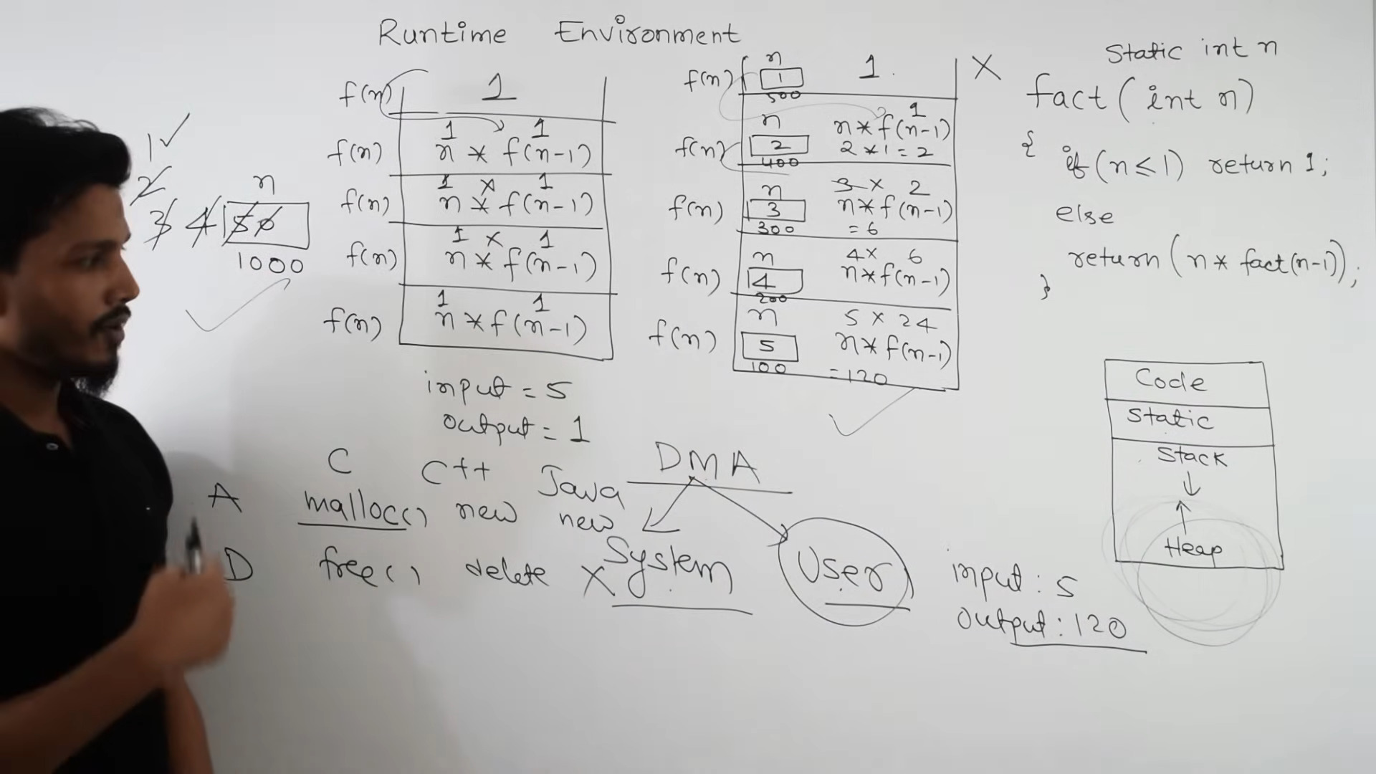

Slide 4
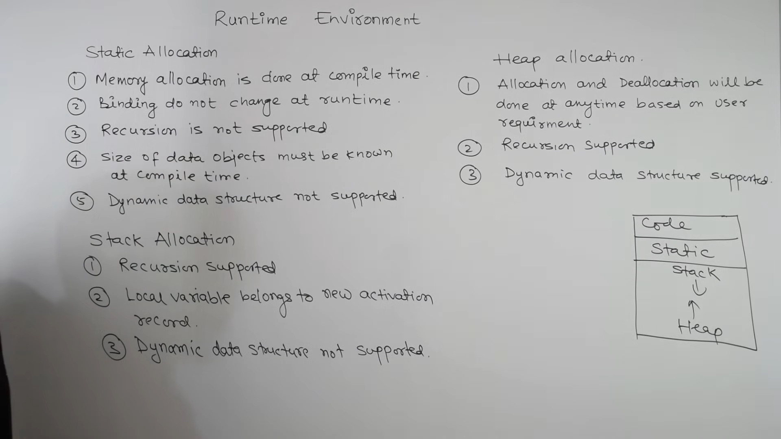

Slide 5
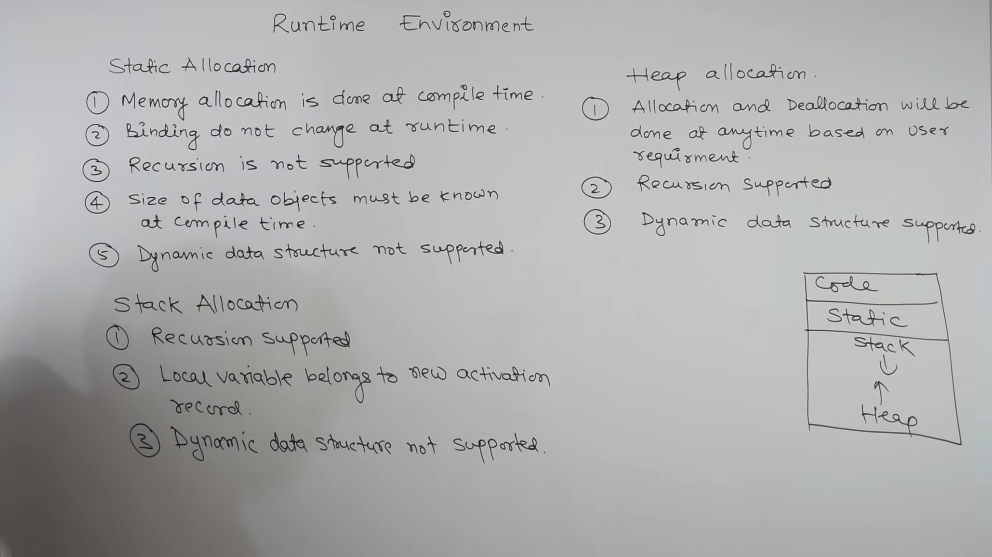

Slide 6
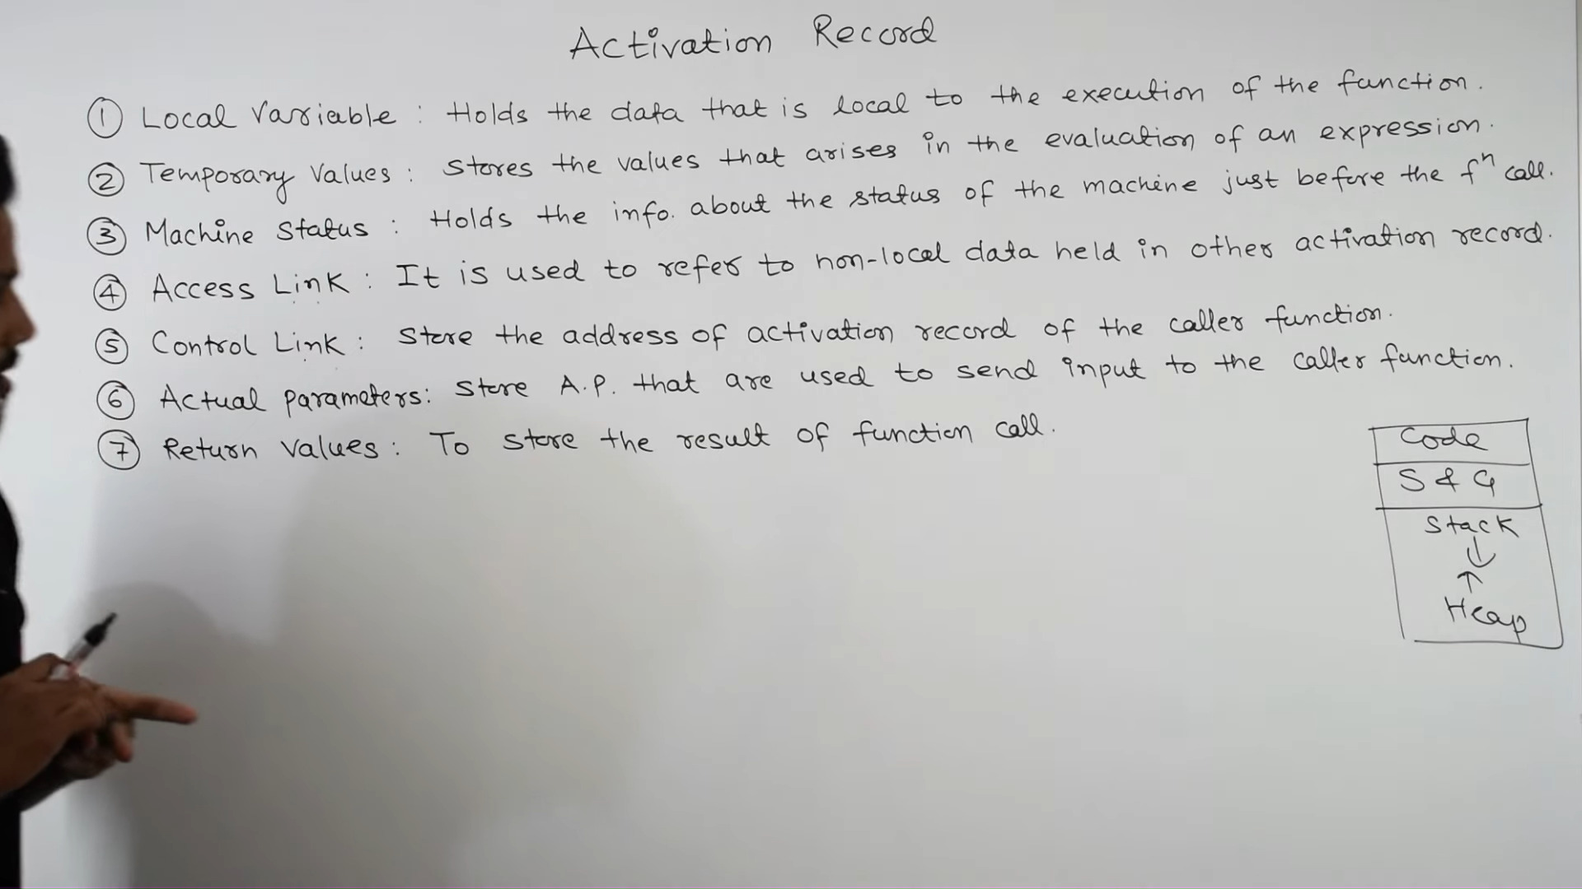

Slide 8
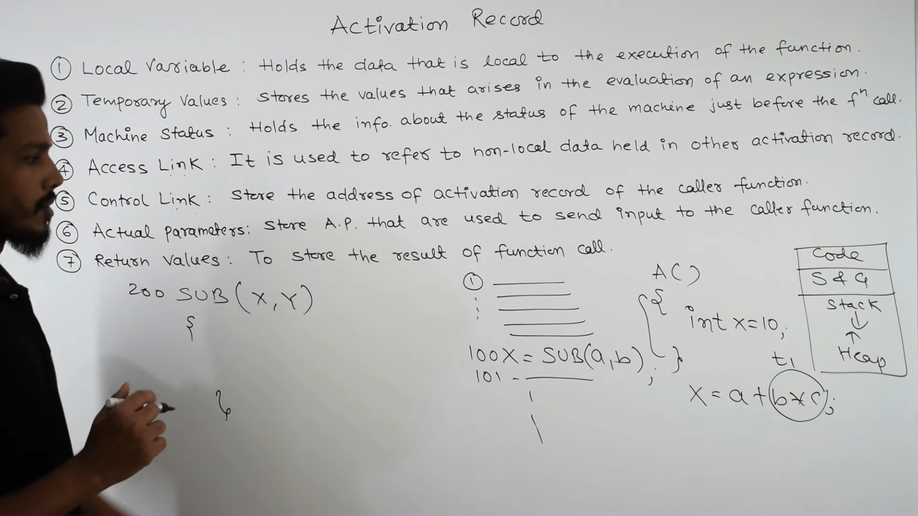

Slide 9
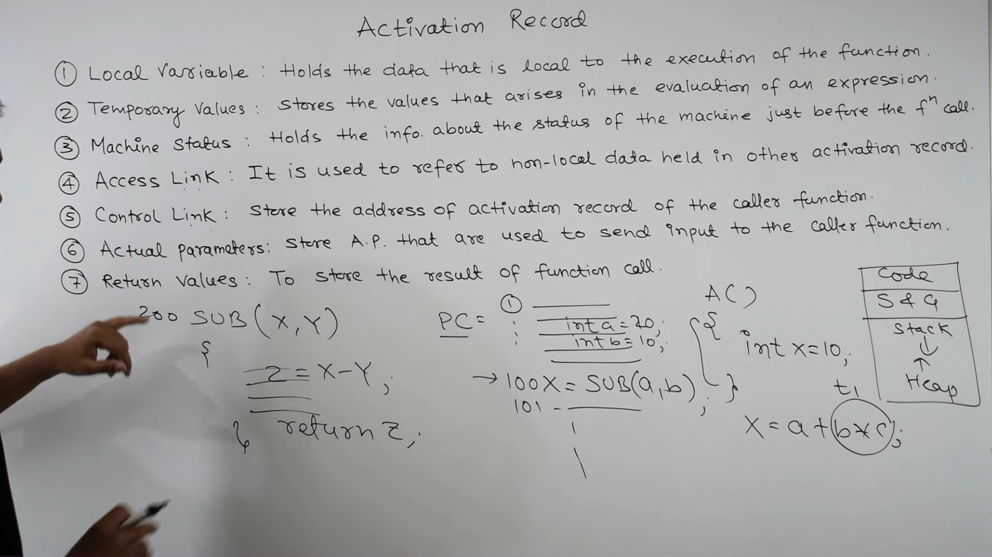

Slide 10
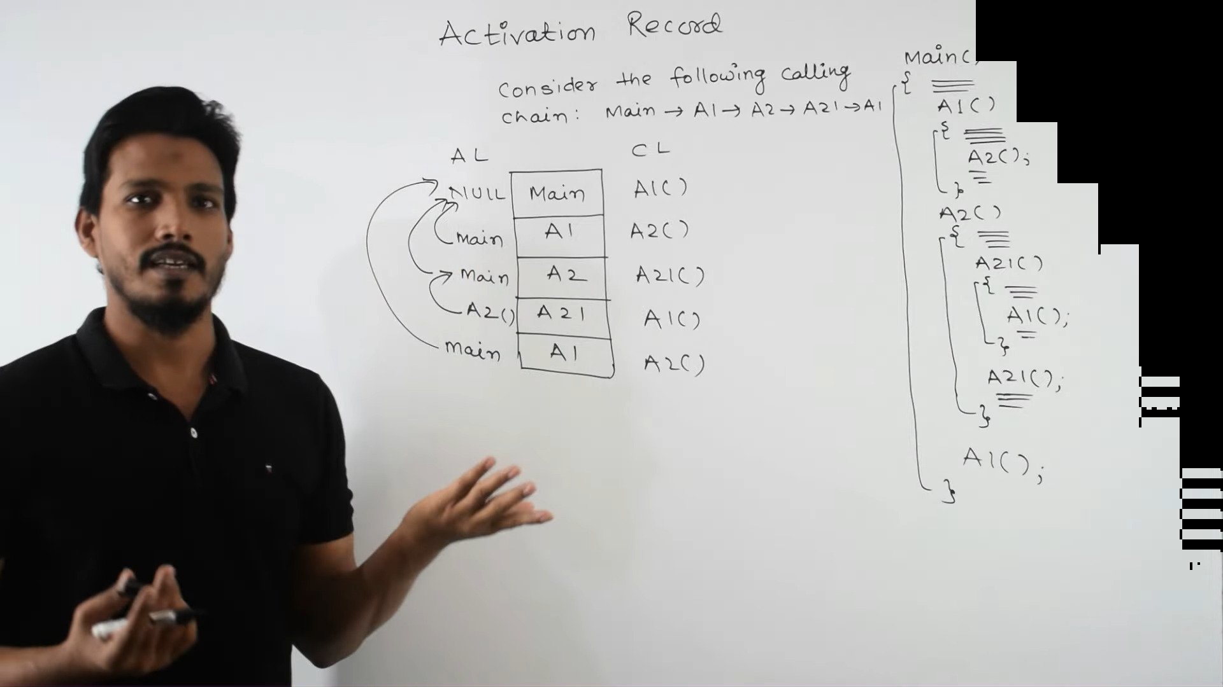

Slide 13
Runtime Environment
Imagine the environment where the target program code is being executed
Issues dealt with here: allocation of storage
access to variables and data
memory management: stack allocation, heap management, (and garbage collection)
Rokan Uddin Faruqui csE, cU
Runtime Environments
2

Slide 14
Runtime Environment
Imagine the environment where the target program code is being executed
Issues dealt with here: allocation of storage
access to variables and data
memory management: stack allocation, heap management, (and garbage collection)
Rokan Uddin Faruqui csE, cU
Runtime Environments
3

Slide 15
Runtime Environment
Imagine the environment where the target program code is being executed
Issues dealt with here: allocation of storage
access to variables and data
memory management: stack allocation, heap management, (and garbage collection)
Runtime Environments

Slide 16
Scanner (lexical analysis)
Parser (syntax analysis
Semantic analysis and intermediate code generation Machine-independent code improvement (optional) Target code generation
Machine-specific code improvement (optional)
Figure: Phases of compilation
Runtime Environments

Slide 17




Outline
1
Storage organization
Stack Allocation of Space
Non-local data
Heap Management
Runtime Environments

Slide 18



Outline
storage organization
1
Storage organization
Stack Allocation of Space
Non-local data
Heap Management
Runtime Environments

Slide 19
Static vs Dynamic Storage Allocation
storage organization
int a;
Static means “at compile time“ Dynamic means “at runtime“
Stack has data local to (procedure) call.
Layout known statically
Managed automatically by generated code Heap has data that survives between (procedure) calls.
Layout not known statically
Managed dynamically by garbage collector
Runtime Environments

Slide 20
Static vs Dynamic Storage Allocation
storage organization
Static means “at compile time“ Dynamic means “at runtime“
Stack has data local to (procedure) call.
Layout known statically
Managed automatically by generated code Heap has data that survives between (procedure) calls.
Layout not known statically
Managed dynamically by garbage collector
Rokan Uddin Faruqui csE, cU
Runtime Environments
9

Slide 21
Static vs Dynamic Storage Allocation
storage organization
Static means “at compile time“ Dynamic means “at runtime“
Stack has data local to (procedure) call.
Layout known statically
Managed automatically by generated code Heap has data that survives between (procedure) calls.
Layout not known statically
Managed dynamically by garbage collector
Rokan Uddin Faruqui csE, cU
Runtime Environments
10

Slide 22
Static vs Dynamic Storage Allocation
storage organization
Static means “at compile time“ Dynamic means “at runtime“
Stack has data local to (procedure) call.
Layout known statically
Managed automatically by generated code Heap has data that survives between (procedure) calls.
Layout not known statically
Managed dynamically by garbage collector
Rokan Uddin Faruqui csE, cU
Runtime Environments
11

Slide 23
Static vs Dynamic Storage Allocation
storage organization
Static means “at compile time“ Dynamic means “at runtime“
Stack has data local to (procedure) call.
Layout known statically
Managed automatically by generated code Heap has data that survives between (procedure) calls.
Layout not known statically
Managed dynamically by garbage collector
Rokan Uddin Faruqui csE, cU
Runtime Environments
12

Slide 24
Static vs Dynamic Storage Allocation
storage organization
Static means “at compile time“ Dynamic means “at runtime“
Stack has data local to (procedure) call.
Layout known statically
Managed automatically by generated code Heap has data that survives between (procedure) calls.
Layout not known statically
Managed dynamically by garbage collector
Rokan Uddin Faruqui csE, cU
Runtime Environments
13

Slide 25
Static vs Dynamic Storage Allocation
storage organization
Static means “at compile time“ Dynamic means “at runtime“
Stack has data local to (procedure) call.
Layout known statically
Managed automatically by generated code Heap has data that survives between (procedure) calls.
Layout not known statically
Managed dynamically by garbage collector
Runtime Environments

Slide 26
Garbage Collector
storage organization
Purpose: Enables the runtime system to detect useless data elements, and reuse their storage. Automated in most modern languages.
Runtime Environments

Slide 27
Storage Organization
storage organization
“Runtime representation of an object program”
Code area instructions, address pointers. Static area global constants.
Heap objects, records, arrays, variable strings.¹ Stack activation records/stack frames;
objects, records, arrays, variable strings.²
Runtime Environments

Slide 28
storage organization
Storage Organization
Static | Code
 | Static
Dynamic | Heap
 | ↓ Free Memory ↑
 | Stack
lowest address
highest address
Runtime Environments

Slide 29
Storage Organization
storage organization
Code area executable target code, statically determined.
Static area data generated by the compiler known at compile time.
Heap grows towards higher addresses Stack grows towards lower addresses
Runtime Environments

Slide 30

Outline
stack Allocation of space
1
Storage organization
2 Stack Allocation of Space
Non-local data
Heap Management
Runtime Environments

Slide 31
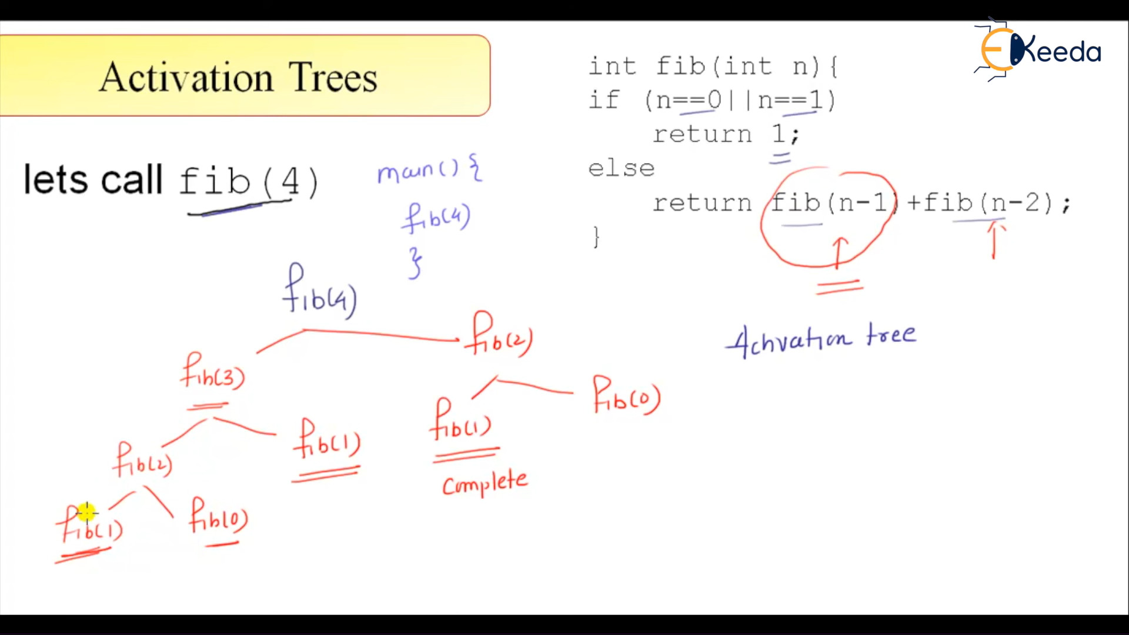

Slide 32
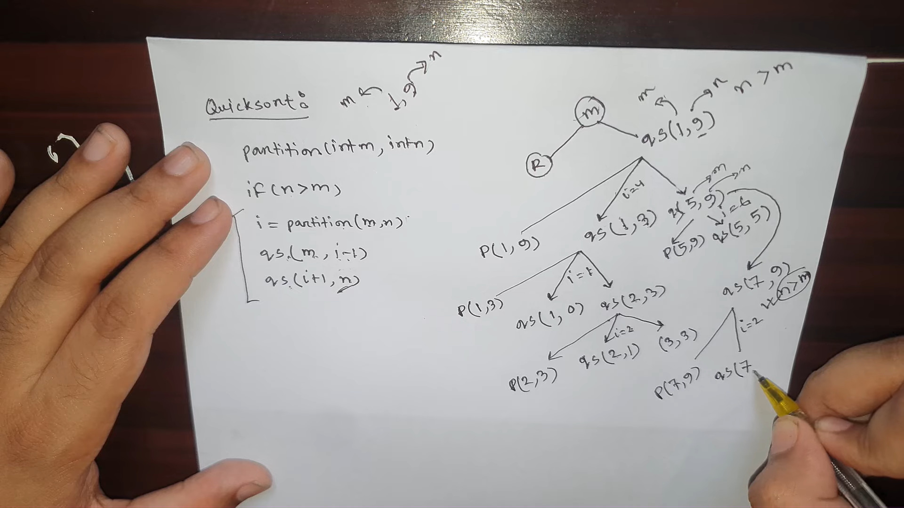

Slide 33
Activation Tree
stack Allocation of space
Shows all calls at runtime.
A call is a child of the callee node. Children are in call order from left to right.
Runtime Environments

Slide 34
Activation Tree
stack Allocation of space
Shows all calls at runtime.
A call is a child of the callee node. Children are in call order from left to right.
Runtime Environments

Slide 35
Activation Tree
stack Allocation of space
Shows all calls at runtime.
A call is a child of the callee node. Children are in call order from left to right.
Runtime Environments

Slide 36




Activation Tree Example - QuickSort
stack Allocation of space
void quicksort(int m, int n) {
int i;
if (n > m) {
i = partition(m, n);
9 quicksort(m, i−1); quicksort(i+1, n);
}
}
main() {
18
readArray();
a[0] = −9999;
a[10] = 9999;
quicksort(1,9);
27 }
1 int a[11];
2
void readArray() {
int i;
}
int partition(int m, int n) { 7
8 }
9 void quicksort(int m, int n){
int i;
if (n > m){
i = partition(m,n);
quicksort(m, i−1);
quicksort(i+1, n);
}
Runtime Environments

Slide 37
Activation Tree Example
stack Allocation of space
e n te r read Array ()
l e a v e read Array ()
e n te r q u i c k s o r t ( 1 , 9 )
e n te r p a r t i t i o n ( 1 , 9 )
l e a v e e n te r
. . .
l e a v e e n te r
. . .
p a r t i t i o n ( 1 , 9 )
q u i c k s o r t ( 1 , 3 )
q u i c k s o r t ( 1 , 3 ) q u i c k s o r t ( 5 , 9 )
l e a v e q u i c k s o r t ( 5 , 9 ) l e a v e q u i c k s o r t ( 1 , 9 )
l e a v e main ()
Runtime Environments

Slide 38

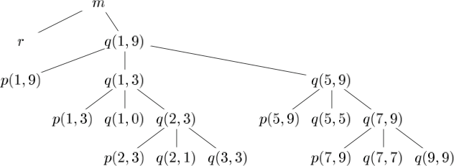
Activation Tree Example
stack Allocation of space
Figure: Activation tree representing calls during an execution of quicksort
Runtime Environments

Slide 39
Contents of Activation Record
stack Allocation of space
Actual parameters (commonly in registers instead). Space for return value.
Control link (caller’s activation record, “dynamic link”). Access link (“static link”).
Saved machine state (notably return address). Local data for called procedure.
Temporary values that do not fit in registers.
1
2
3
4
5
6
7
Runtime Environments

Slide 40
Contents of Activation Record
stack Allocation of space
1
Actual parameters (commonly in registers instead).
2
Space for return value.
Control link (caller’s activation record, “dynamic link”). Access link (“static link”).
Saved machine state (notably return address). Local data for called procedure.
Temporary values that do not fit in registers.
3
4
5
6
7
Runtime Environments

Slide 41
Contents of Activation Record
stack Allocation of space
Actual parameters (commonly in registers instead). Space for return value.
1
2
³ Control link (caller’s activation record, “dynamic link”).
Access link (“static link”).
Saved machine state (notably return address). Local data for called procedure.
Temporary values that do not fit in registers.
4
5
6
7
Runtime Environments

Slide 42
Contents of Activation Record
stack Allocation of space
Actual parameters (commonly in registers instead). Space for return value.
Control link (caller’s activation record, “dynamic link”).
1
2
3
⁴ Access link (“static link”).
Saved machine state (notably return address). Local data for called procedure.
Temporary values that do not fit in registers.
5
6
7
Runtime Environments

Slide 43

Contents of Activation Record
stack Allocation of space
Actual parameters (commonly in registers instead). Space for return value.
Control link (caller’s activation record, “dynamic link”). Access link (“static link”).
Saved machine state (notably return address). Local data for called procedure.
1
2
3
4
5
6
7
Temporary values that do not fit in registers.
Runtime Environments

Slide 44
Contents of Activation Record
stack Allocation of space
Actual parameters (commonly in registers instead). Space for return value.
Control link (caller’s activation record, “dynamic link”). Access link (“static link”).
Saved machine state (notably return address). Local data for called procedure.
Temporary values that do not fit in registers.
1
2
3
4
5
6
7
Runtime Environments

Slide 45
Contents of Activation Record
stack Allocation of space
Actual parameters (commonly in registers instead). Space for return value.
Control link (caller’s activation record, “dynamic link”). Access link (“static link”).
Saved machine state (notably return address). Local data for called procedure.
Temporary values that do not fit in registers.
1
2
3
4
5
6
7
Runtime Environments

Slide 46
stack Allocation of space
Activation Record or “Frame”
. . .
Actual Parameters
Return Values
Control Link
Access Link
Saved Machine State
Local Data
Temporaries
↓
Runtime Environments

Slide 47
Activation Record or “Frame”
stack Allocation of space
a = b + c / 4 t1 = c / 4
a = b + t1
1
Temporary values, such as those arising from the evaluation of expressions
Local data belonging to the procedure whose activation record this is.
A saved machine status just before the call to the procedure. Such as return address
An access link may be needed to locate data needed by the called procedure but found elsewhere
A control link, pointing to the activation record of the caller. Space for the return value of the called function, if any.
The actual parameters used by the calling procedure
2
3
4
5
6
7
Runtime Environments

Slide 48

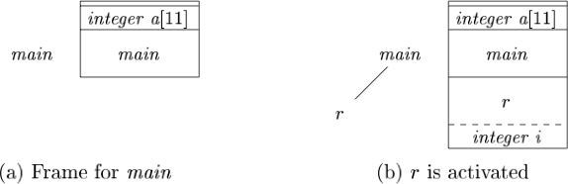
Snapshot of run-time stack for ’quicksort’
stack Allocation of space
Dashed lines in the partial trees go to activations that have ended.
Since array a is global, space is allocated for it before execution begins with an activation of procedure main, as shown in
Figure: Downward growing stack of activation records
Runtime Environments

Slide 49

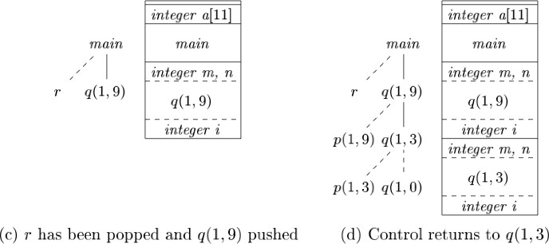
Snapshot of run-time stack for ’quicksort’
stack Allocation of space
Figure: Downward growing stack of activation records
Runtime Environments

Slide 50
Where Is My Activation Record?
stack Allocation of space
. . .
Actual Parameters
Return Values
Control Link
Access Link
Saved Machine State
Local Data
Temporaries
↓
Keep actual (top) frame’s Frame Pointer (FP) in a register.
Keep track of Local Stack Size (SP) in a register.
Variable-length data on stack.
FP →
SP →
Runtime Environments

Slide 51
Where Is My Activation Record?
stack Allocation of space
. . .
Actual Parameters
Return Values
Control Link
Access Link
Saved Machine State
Local Data
Temporaries
↓
Keep actual (top) frame’s Frame Pointer (FP) in a register.
Keep track of Local Stack Size (SP) in a register.
Variable-length data on stack.
FP →
SP →
Runtime Environments

Slide 52
Where Is My Activation Record?
stack Allocation of space
. . .
Actual Parameters
Return Values
Control Link
Access Link
Saved Machine State
Local Data
Temporaries
↓
Keep actual (top) frame’s Frame Pointer (FP) in a register.
Keep track of Local Stack Size (SP) in a register.
Variable-length data on stack.
FP →
SP →
Runtime Environments

Slide 53
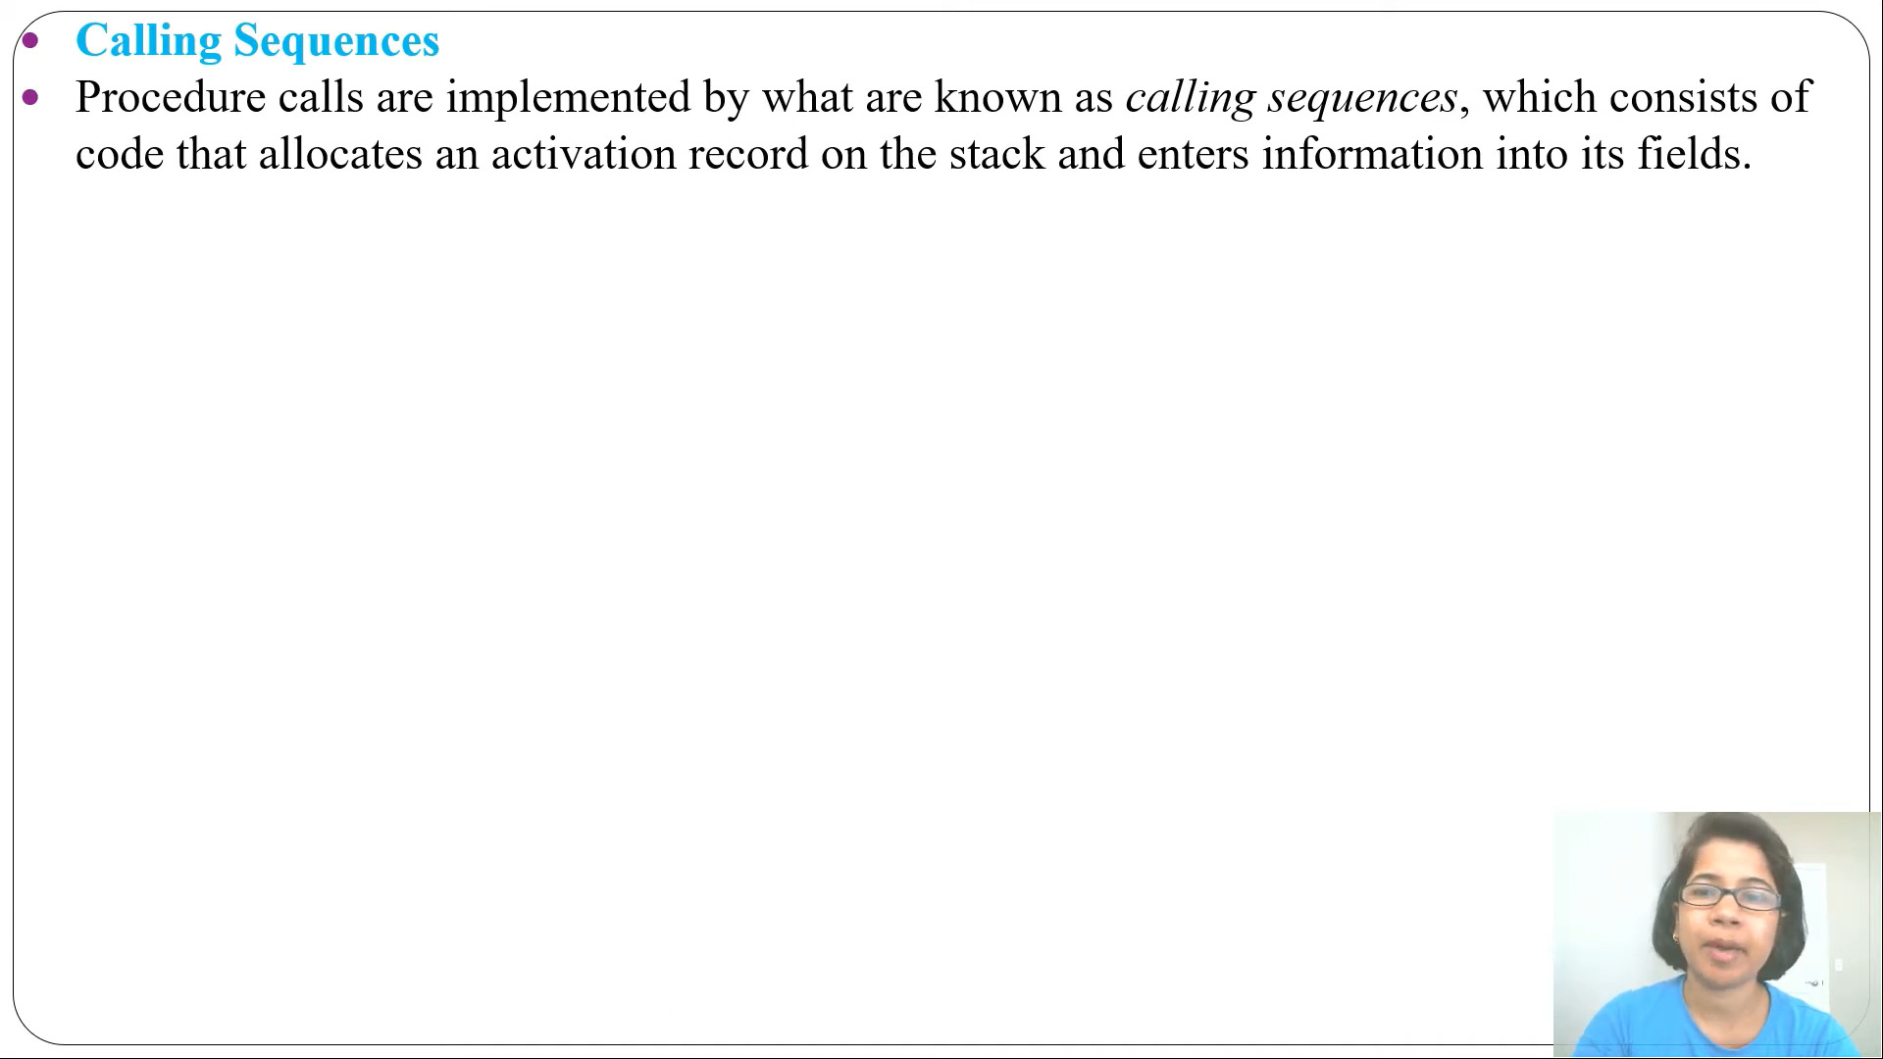

Slide 54
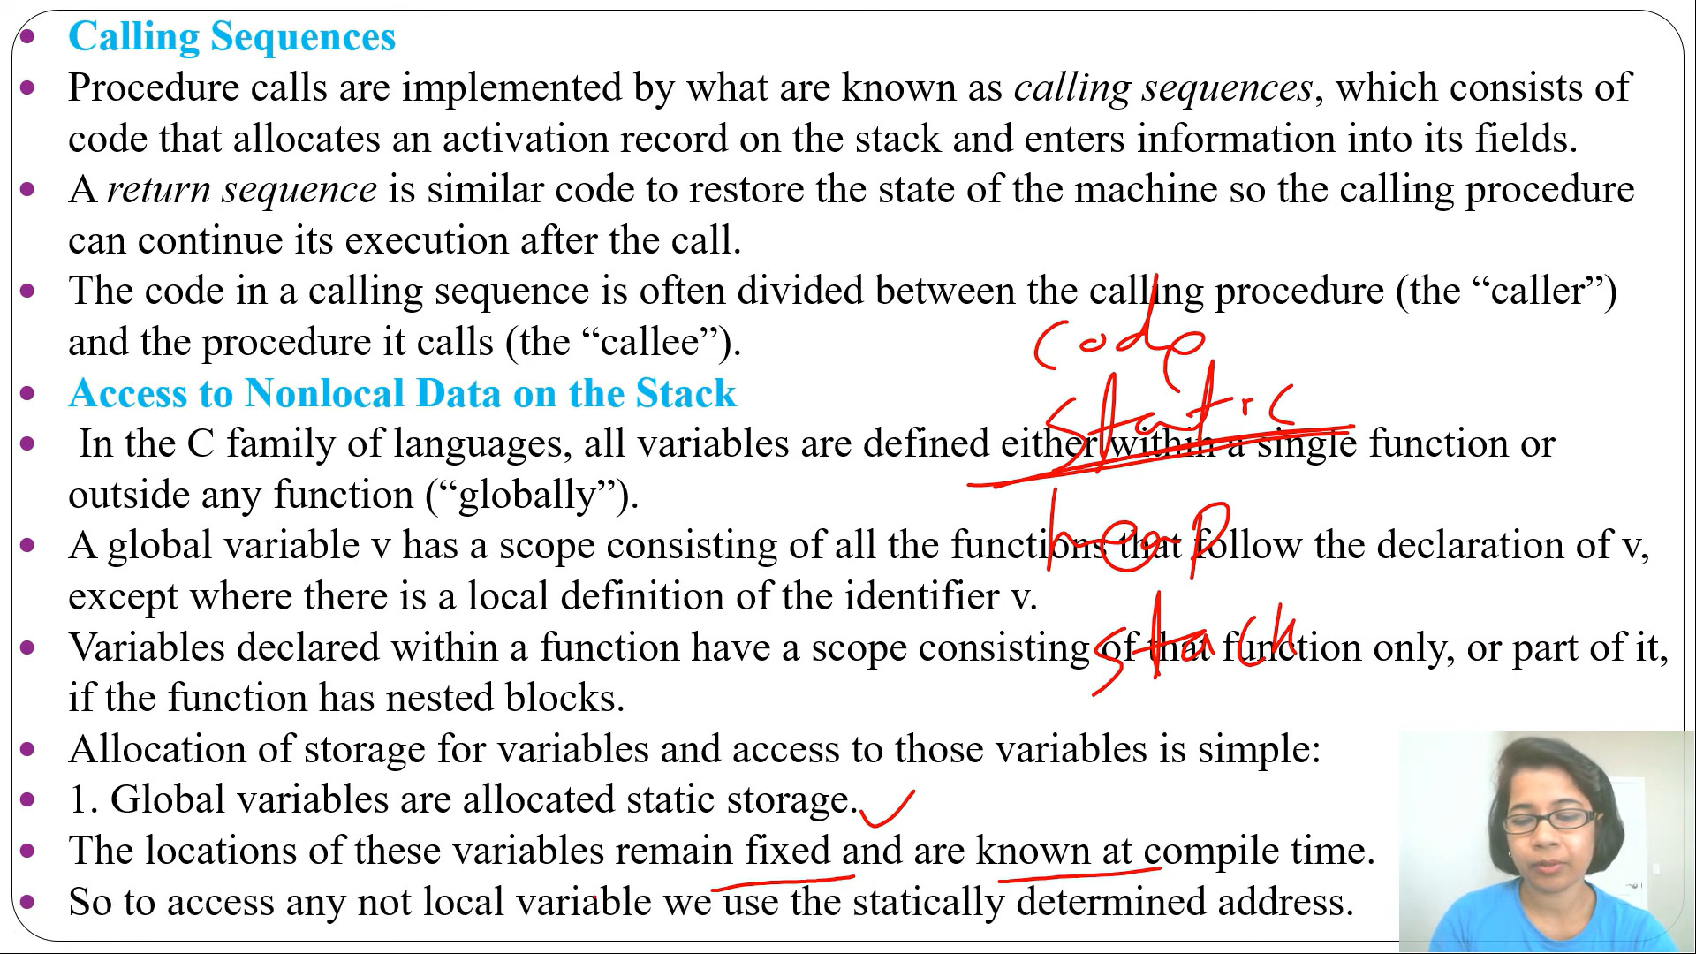

Slide 55
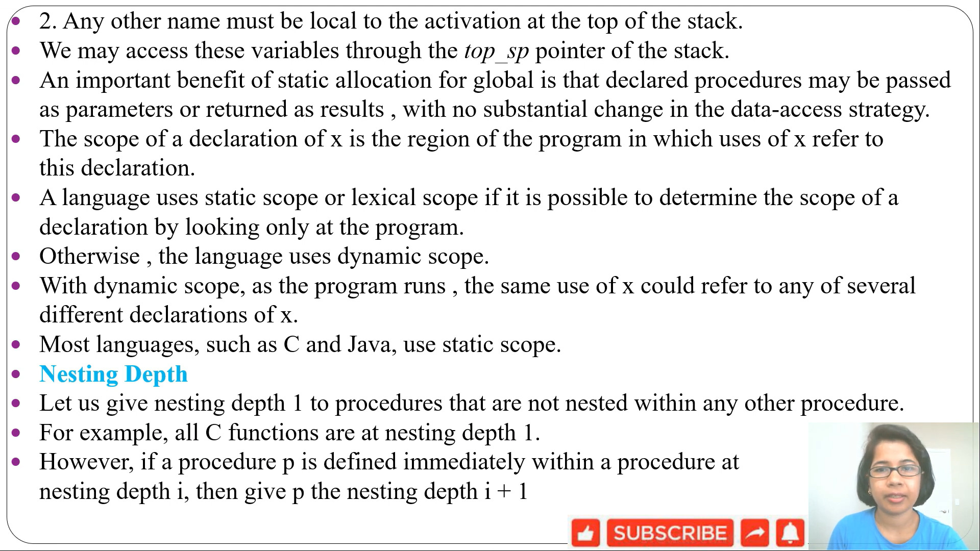

Slide 59
Calling Sequence
stack Allocation of space
Calling sequences consists of code that allocates an activation record on the stack and enters information into its
fields:
caller allocates space for and stores actual parameters. caller allocates space for return value.
caller pushes the control/dynamic link (FP).
callee allocates space for and stores access/static link. callee allocates space for and stores saved machine state. callee allocates space for local data.
callee runs and might use temporaries while it runs
1
2
3
4
5
6
7
Runtime Environments

Slide 60
Calling Sequence
stack Allocation of space
Calling sequences consists of code that allocates an activation record on the stack and enters information into its
fields:
caller allocates space for and stores actual parameters. caller allocates space for return value.
caller pushes the control/dynamic link (FP).
callee allocates space for and stores access/static link. callee allocates space for and stores saved machine state. callee allocates space for local data.
callee runs and might use temporaries while it runs
1
2
3
4
5
6
7
Rokan Uddin Faruqui csE, cU
Runtime Environments
41

Slide 61
Calling Sequence
stack Allocation of space
Calling sequences consists of code that allocates an activation record on the stack and enters information into its
fields:
caller allocates space for and stores actual parameters. caller allocates space for return value.
caller pushes the control/dynamic link (FP).
callee allocates space for and stores access/static link. callee allocates space for and stores saved machine state. callee allocates space for local data.
callee runs and might use temporaries while it runs
1
2
3
4
5
6
7
Rokan Uddin Faruqui csE, cU
Runtime Environments
42

Slide 62
Calling Sequence
stack Allocation of space
Calling sequences consists of code that allocates an activation record on the stack and enters information into its
fields:
caller allocates space for and stores actual parameters. caller allocates space for return value.
caller pushes the control/dynamic link (FP).
callee allocates space for and stores access/static link. callee allocates space for and stores saved machine state. callee allocates space for local data.
callee runs and might use temporaries while it runs
1
2
3
4
5
6
7
Rokan Uddin Faruqui csE, cU
Runtime Environments
43

Slide 63
Calling Sequence
stack Allocation of space
Calling sequences consists of code that allocates an activation record on the stack and enters information into its
fields:
caller allocates space for and stores actual parameters. caller allocates space for return value.
caller pushes the control/dynamic link (FP).
callee allocates space for and stores access/static link. callee allocates space for and stores saved machine state. callee allocates space for local data.
callee runs and might use temporaries while it runs
1
2
3
4
5
6
7
Rokan Uddin Faruqui csE, cU
Runtime Environments
44

Slide 64
Calling Sequence
stack Allocation of space
Calling sequences consists of code that allocates an activation record on the stack and enters information into its
fields:
caller allocates space for and stores actual parameters. caller allocates space for return value.
caller pushes the control/dynamic link (FP).
callee allocates space for and stores access/static link. callee allocates space for and stores saved machine state. callee allocates space for local data.
callee runs and might use temporaries while it runs
1
2
3
4
5
6
7
Rokan Uddin Faruqui csE, cU
Runtime Environments
45

Slide 65
Calling Sequence
stack Allocation of space
Calling sequences consists of code that allocates an activation record on the stack and enters information into its
fields:
caller allocates space for and stores actual parameters. caller allocates space for return value.
caller pushes the control/dynamic link (FP).
callee allocates space for and stores access/static link. callee allocates space for and stores saved machine state. callee allocates space for local data.
callee runs and might use temporaries while it runs
1
2
3
4
5
6
7
Runtime Environments

Slide 66
Calling Sequence, continued.
stack Allocation of space
Calling sequences consists of code that allocates an activation record on the stack and enters information into its
fields:
callee cleans up local material (pops local data and temporaries). callee restores caller’s machine state (includes “jumping back”). caller extracts return value and recovers space used for parameters.
1
2
3
Runtime Environments

Slide 67
Calling Sequence, continued.
stack Allocation of space
Calling sequences consists of code that allocates an activation record on the stack and enters information into its
fields:
callee cleans up local material (pops local data and temporaries). callee restores caller’s machine state (includes “jumping back”). caller extracts return value and recovers space used for parameters.
1
2
3
Runtime Environments

Slide 68
Outline
Non-local data
1
Storage organization
2 Stack Allocation of Space
3 Non-local data
4 Heap Management
Runtime Environments

Slide 69

Easy: C (no nested procedures, static scoping)
Non-local data
how procedures access their data, also data from other procedures
Global and static data goes in static section. Everything else is by default on the stack. Explicit malloc() and free() manage the heap
Runtime Environments

Slide 70

Harder: C++, C#, Java, Scala, ML, Haskell, …
Non-local data
Has nested procedures.
Uses access link (“static link”) or display.
Runtime Environments

Slide 71
Outline
Heap Management
1
Storage organization
Stack Allocation of Space
Non-local data
4 Heap Management
Runtime Environments

Slide 72
Heap Management
The Heap
Static | Code
 | Static
Dynamic | Heap
 | ↓ Free Memory ↑
 | Stack
lowest address
highest address
Runtime Environments

Slide 73

The Heap
Heap Management
Heap objects may live indefinitely. “Life span” is managed automatically or from program (memory manager).
Java
new
C C++
malloc new
Allocation Deallocation
garbage c.
free
delete
Runtime Environments

Slide 74
Memory Manager: function and properties
Heap Management
Allocation get contiguous chunk of bytes (sometimes virtual memory).
Deallocation release previously allocated chunk for reuse.
Desired properties of a memory manager:
Space efficiency Use the available memory well (avoid fragmentation).
Program efficiency Make access to the allocated memory fast (use locality aspects).
Low overhead Reduce administrative cost of allocation.
Runtime Environments

Slide 75
Memory Manager: function and properties
Heap Management
Allocation get contiguous chunk of bytes (sometimes virtual memory).
Deallocation release previously allocated chunk for reuse.
Desired properties of a memory manager:
Space efficiency Use the available memory well (avoid fragmentation).
Program efficiency Make access to the allocated memory fast (use locality aspects).
Low overhead Reduce administrative cost of allocation.
Rokan Uddin Faruqui csE, cU
Runtime Environments
56

Slide 76
Memory Manager: function and properties
Heap Management
Allocation get contiguous chunk of bytes (sometimes virtual memory).
Deallocation release previously allocated chunk for reuse.
Desired properties of a memory manager:
Space efficiency Use the available memory well (avoid fragmentation).
Program efficiency Make access to the allocated memory fast (use locality aspects).
Low overhead Reduce administrative cost of allocation.
Runtime Environments

Slide 77
Memory Hierarchy
Heap Management
Registers 10³ bytes @ 0.2 ns. L1 cache 10⁵ bytes @ 5 ns. L2 cache 10⁷ bytes @ 20 ns.
Physical Memory 10¹⁰ bytes @ 100 ns. Flash Storage 10¹² bytes @ 1 ms.
Disk 10¹⁴ bytes @ 10 ms.
Runtime Environments

Slide 78
Locality
Heap Management
Memory is loaded into cache in chunks.
Multiple access to same chunk improves cache rate. Reorganizing data can drastically improve performance.
Allocator and garbage collector can help!
Runtime Environments

